Slide 1
Authlib
By Sayef Iqbal

Slide 2
The ultimate Python library in building OAuth and OpenID Connect servers.
Theproject is inspired by
OAuthLib
Flask-OAuthlib
requests-oauthlib
pyjwt
OpenID Connect
Authentication Implementations
Framework Integration
Loginpass

Slide 3
Ideal for OAuth 1, OAuth 2 client and session authentication process
It also supports OAuth server authentication. You can run your own authentication server for applications to authenticate against.
We will look at Loginpass and how simply it can be integrated with any flask app.

Slide 4
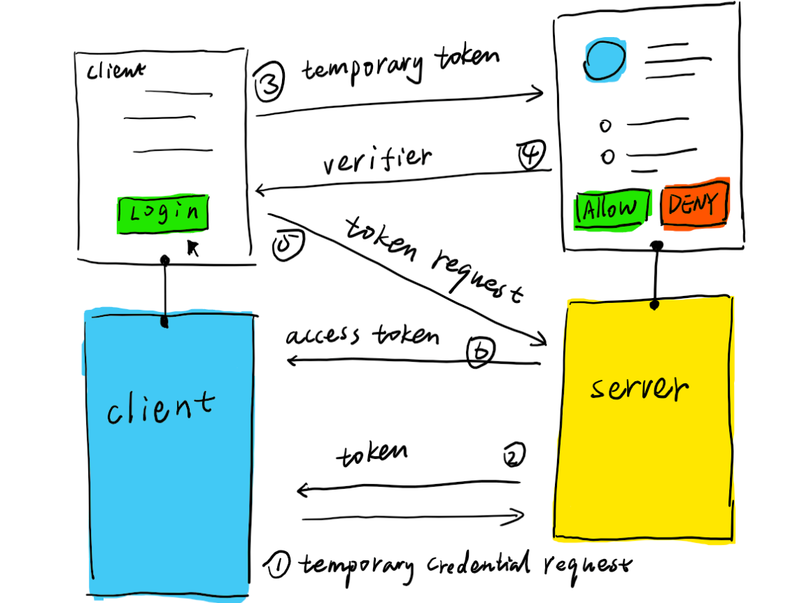
OAuth 1 FLow
Client uses its client credentials to make a request to server, asking the server for a temporary credential.
Server responds with a temporary credential if it verified your client credential.
Client saves temporary credential for later use, then open a view for resource owner to grant the access.
When access is granted, Server responds with a verifier to client.
Client uses this verifier and temporary credential to make a request to the server asking for token credentials.
Server responds with access token if it verified everything.

Slide 5
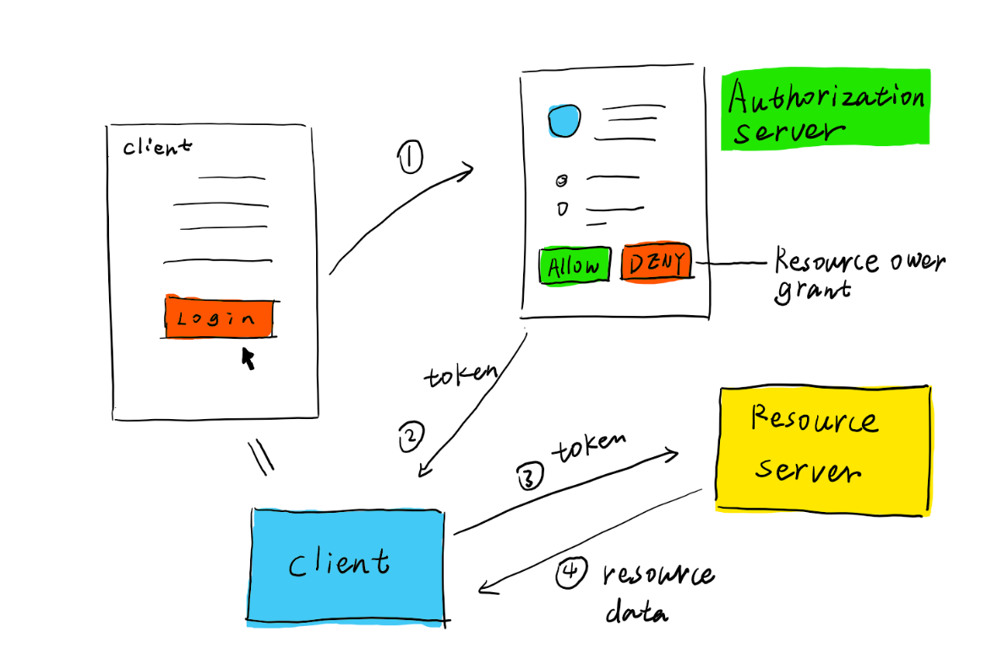
OAuth 2 Flow
Your application (client) prompts the user to log in.
The user clicks the login button, your application will redirect to GitHub’s authorize page (Authorization Server).
The user (he/she is a GitHub user, which means he/she is a Resource Owner) clicks the allow button to tell GitHub that he/she granted the access.
The Authorization Server issues an access token to your application. (This step can contain several sub-steps)
Your application uses the access token to fetch source code from GitHub’s Resource Server, analyze the source code and return the result to your application user.

Slide 6
Some OAuth Clients.
OAuth 1 Client
OAuth 2 Client
Flask OAuth Client - Loginpass
Django OAuth Client
OAuthClient

Slide 7
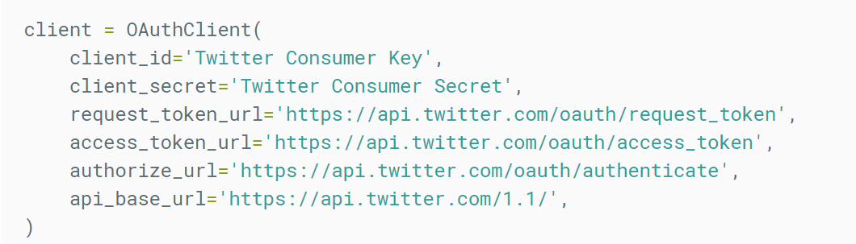
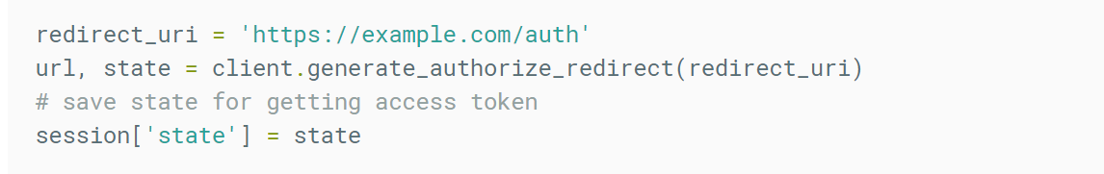
Typical OAuthclient configuration:

Slide 8
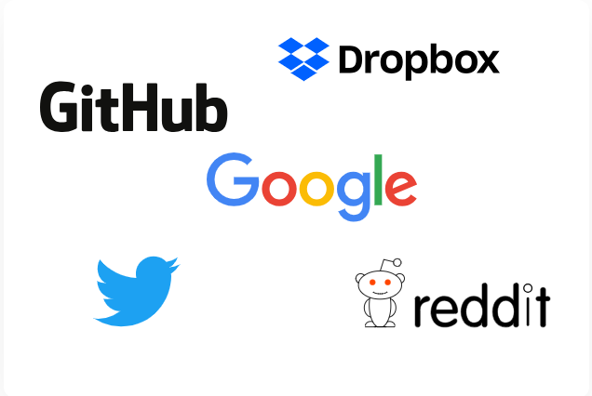
Supporting a wide range of social network service connections. Google with openid connect and service account. Twitter oauth 1 connect Dropbox, reddit, github, facebook etc.. Gitlab and its enterprise oauth. Stackoverflow and its related services.
Loginpass

Slide 9
Google
GitHub
Gitlab
Twitter
Facebook
Dropbox
Reddit
Linkedin
Azure
Discord
Slack
Jira
StackOverflow
Bitbucket
Auth0
Strava
Spotify
Yandex
Twitch
VK

Slide 10
Quick Get Started
Lets Code!

Slide 11
Thank You
Q/A

